Slide 1
Analysis of Rate My Professors
at the City College of New York
Meftahul Ahsan
Mentor: Dr Claude Brathwaite

Slide 2
Rate My Professor
A website where students can express their opinion based on a specific course
Features ratings and reviews of professors from different school, as well as courses taught by individual instructors and assistants
Students publish their ratings that features the following information
Quality: A rating out of 5 based on how well their experience was based on the course
Difficulty: Difficulty rating is also out of 5, depending on the level of course and the course materials and requirements
Comment: A comment written by the student, explaining their opinions and takeaways from the course
Other information include options such as textbook requirements, grade received and the option to take the course again

Slide 3
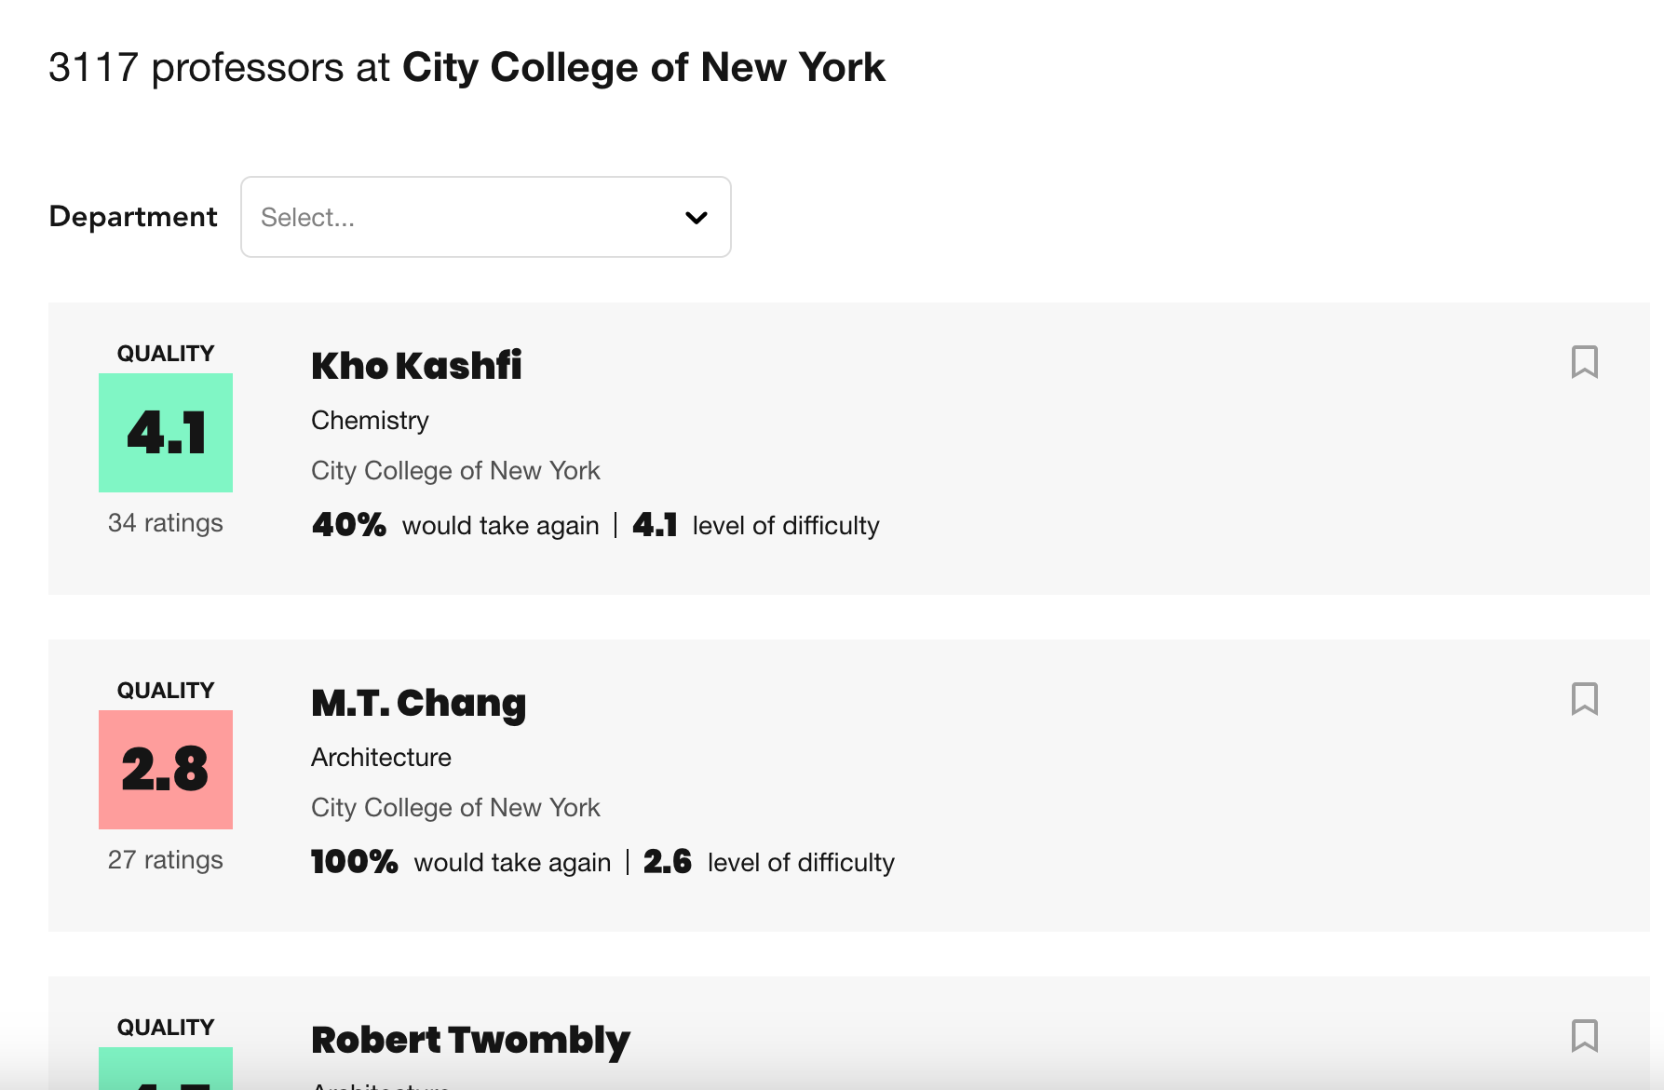
Web Scraping Rate My Professor
Understanding the structure of Rate My Professors
Accessing the HTML page of the City College of New York on Rate My Professors
Finding the elements that contain information on each individual comment posted by the students
Identifying the limitations of Rate My Professors
Iterate through different departments and extract information on professors based on the department
Example: https://www.ratemyprofessors.com/search/professors/224?q=*&did={i}
i is a constant that ranges from 1 to 50, using a loop, i iterate through each department and stores information on professors

Slide 4
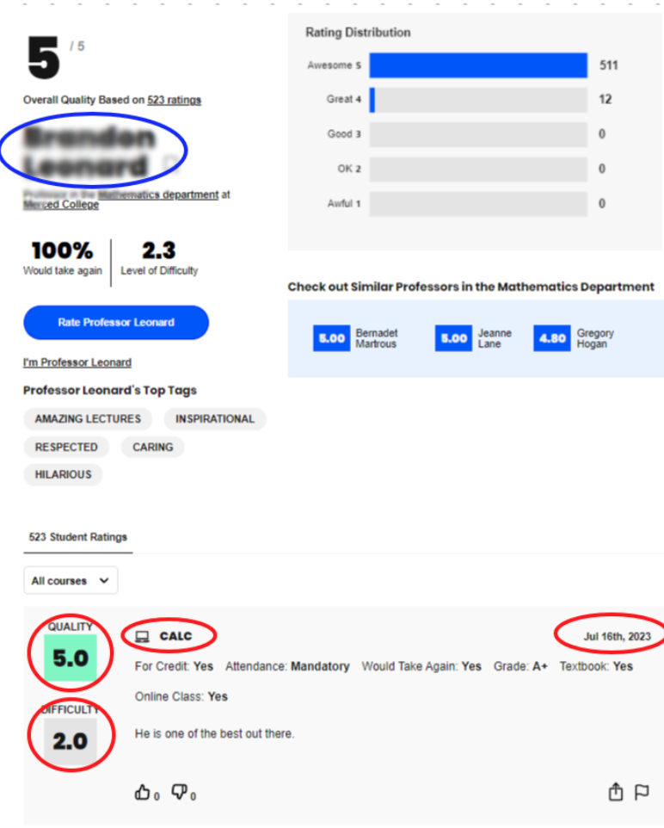
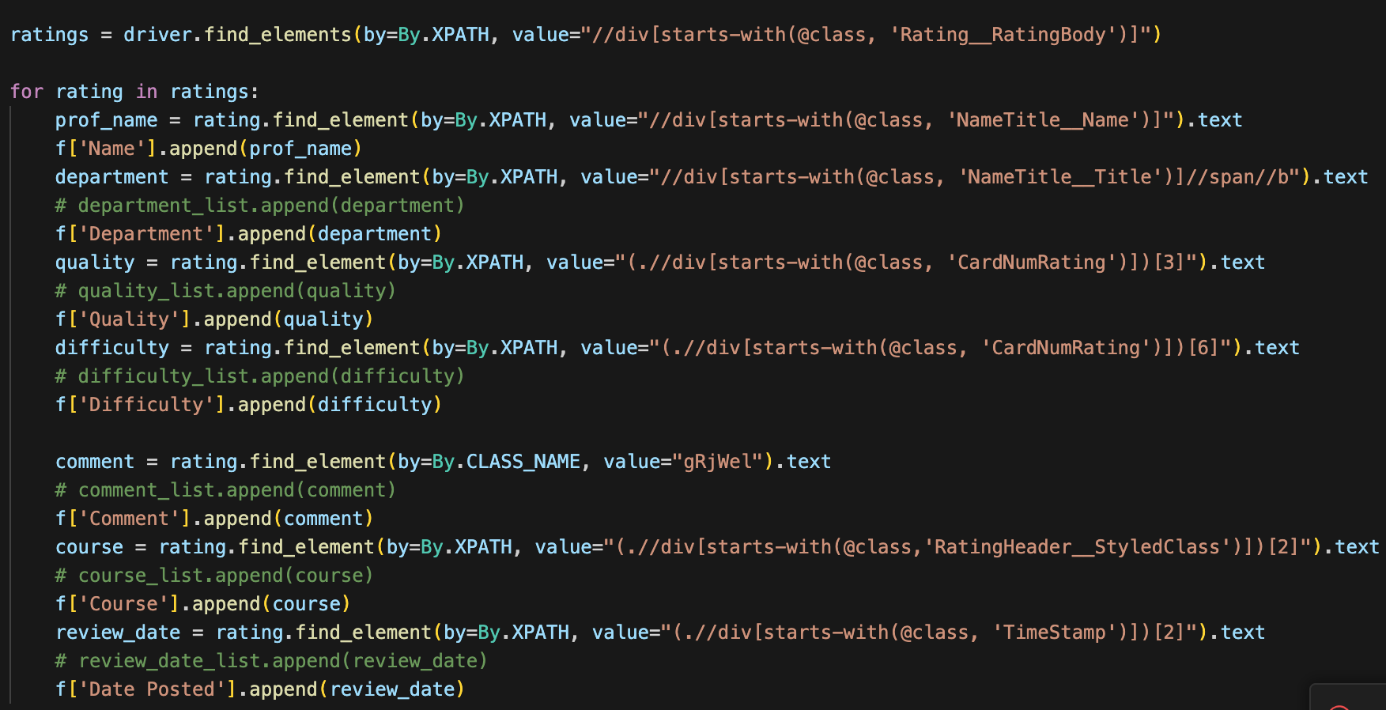
Collection of Data
Use of Python3 and Selenium
An automation process was created using selenium to access and extract data from the HTML source
With the use of XPath elements and find_element method, the automation process were able to extract important information from each profile

Slide 5
Collection of Data
Information of 2246 professors and 51 departments
Total number of reviews: 32,380
After dropping duplicates, number of reviews: 29,874
Reviews were populated by the following departments
Biology: 2,004
Chemistry: 2,490
Mathematics: 4,922
Psychology: 2,850
English: 3,379

Slide 6
Analysis of Data Collected from RMP
Data stored in the CSV file were analyzed using Python pandas.
Several different functions were implemented to analyze data from different time period, on different instructors and by different course based on a department
Natural language toolkit which is available with Python was used to analyze individual comments
Word clouds to represent the qualitative side of the dataframe
Give each professors an individual score which does not rely on the quality or difficulty rating, but based on the comments given by students

Slide 7
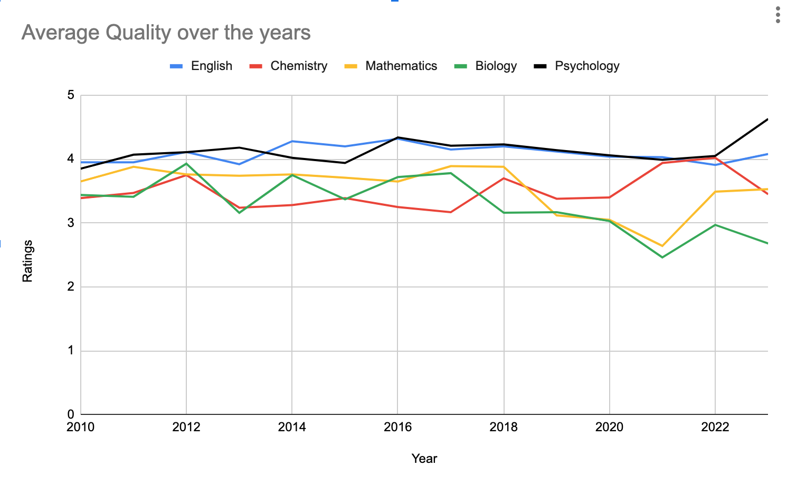

Slide 8
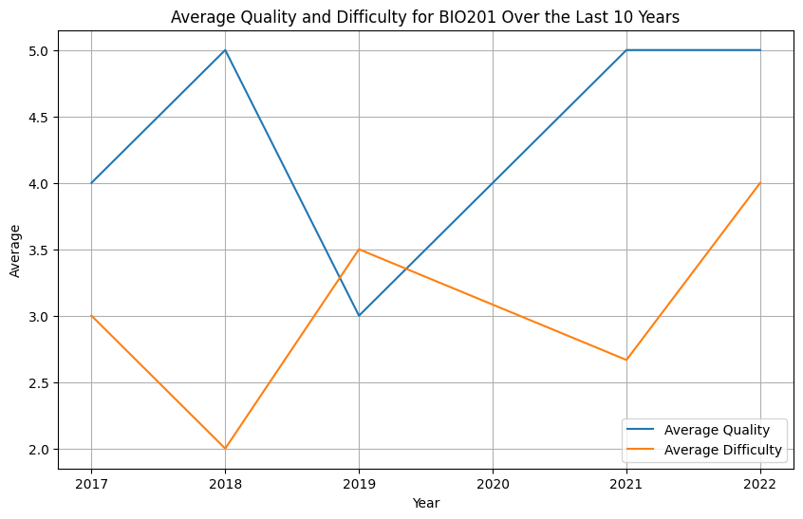
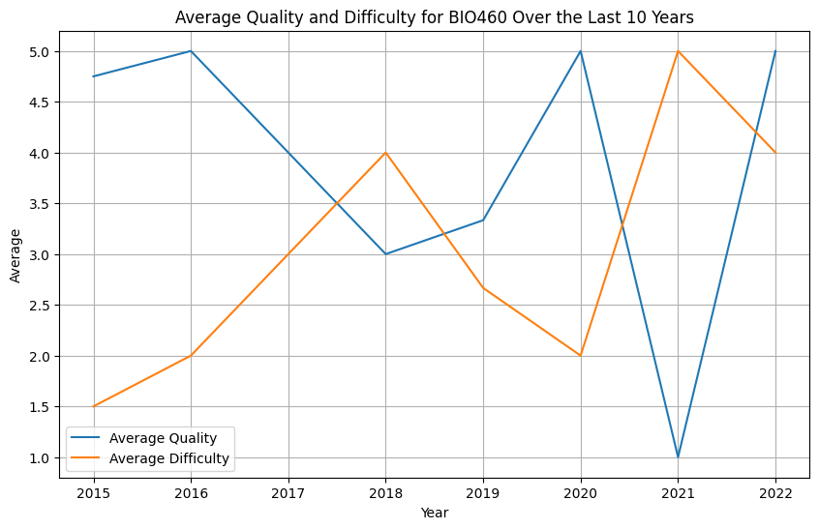
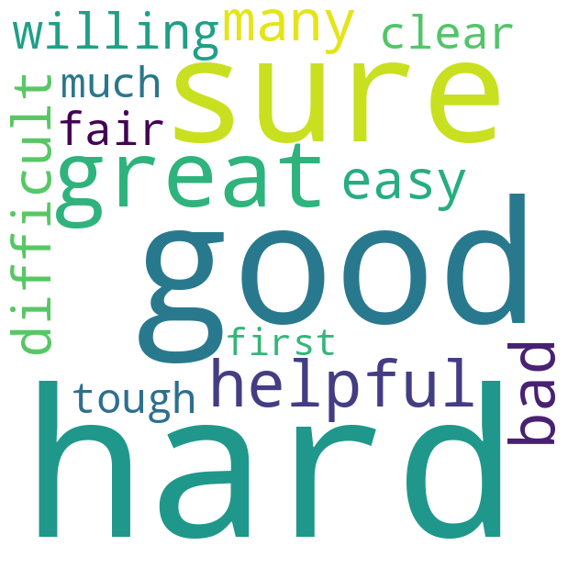
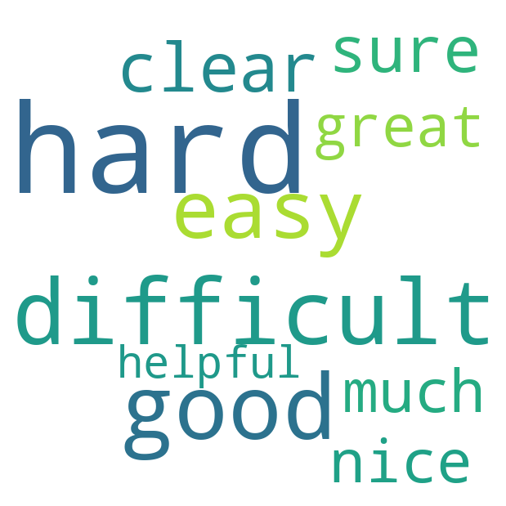

Slide 9
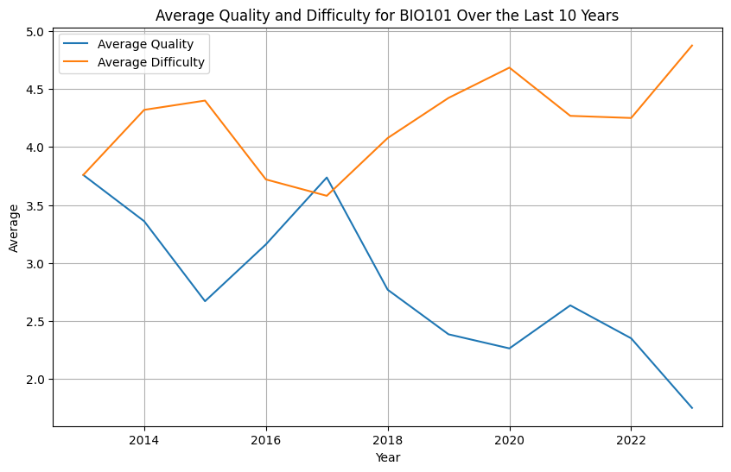
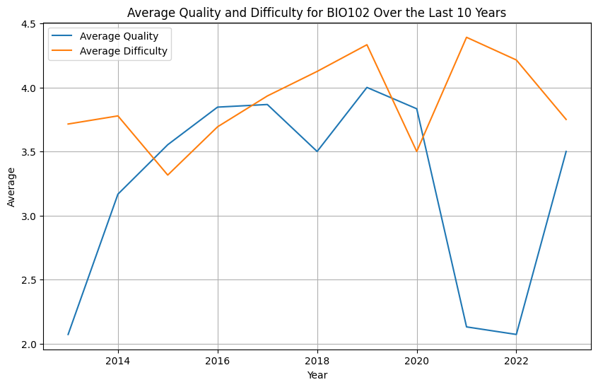
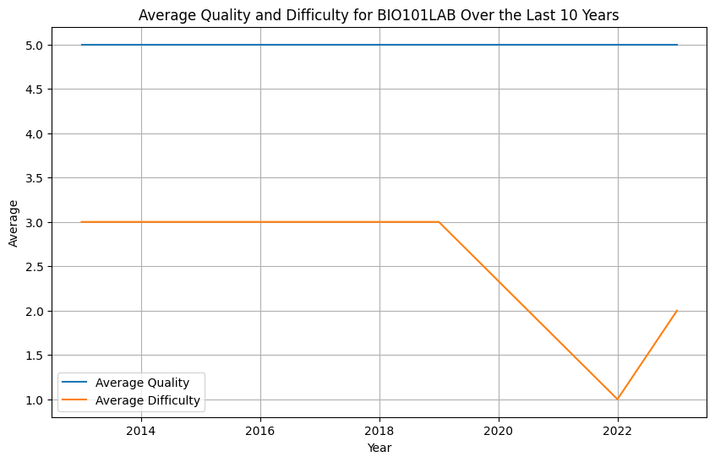
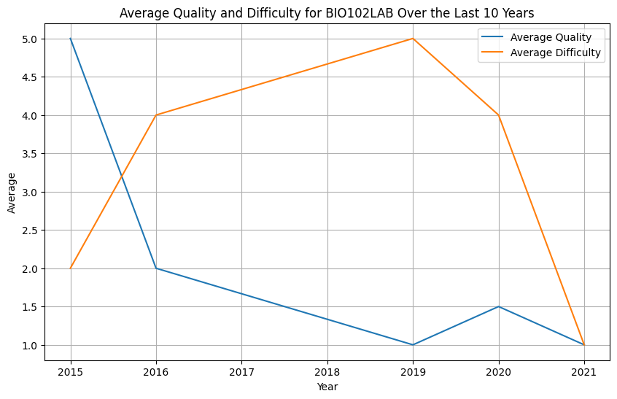

Slide 10
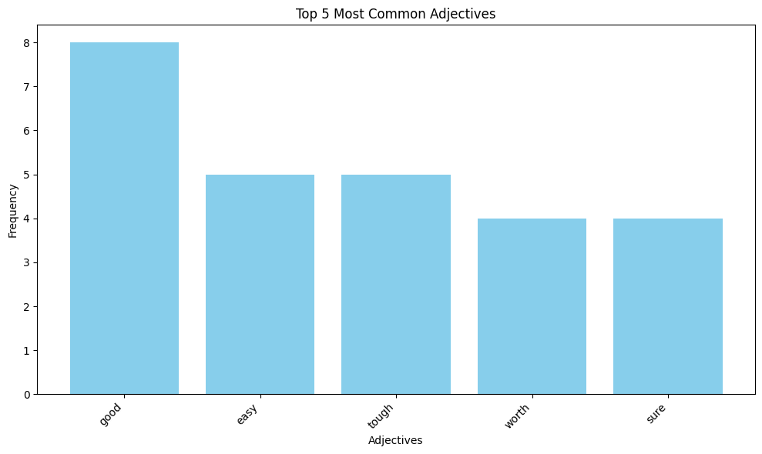
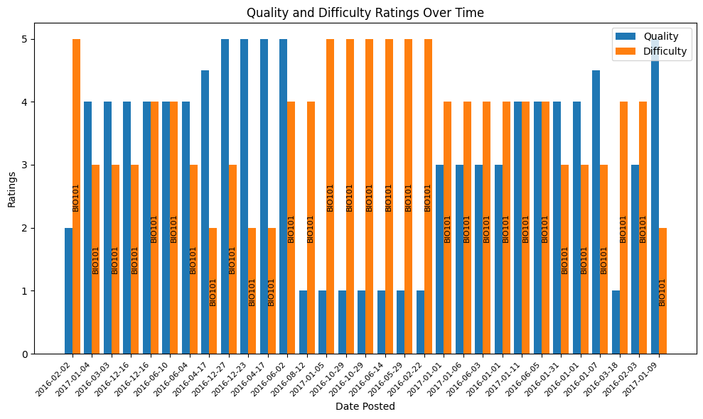
BIO101 (2016-2017)

Slide 11
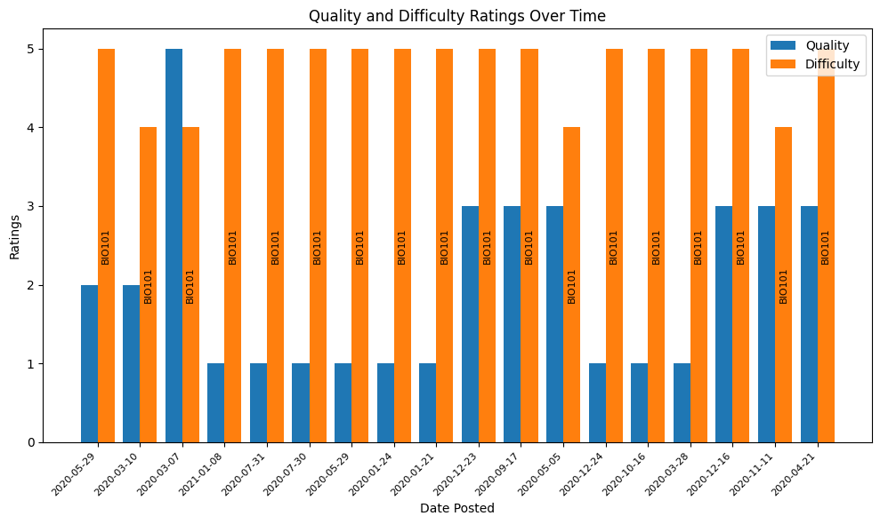
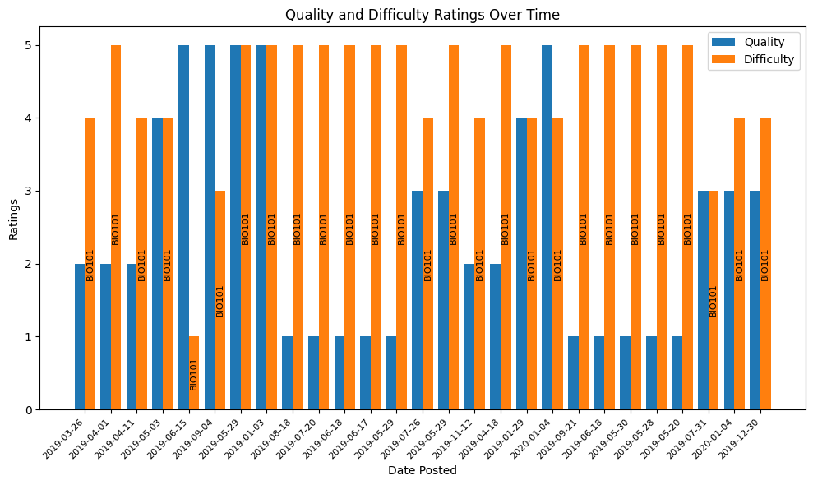
BIO101 2019-2020
BIO101 2020-2021

Slide 12
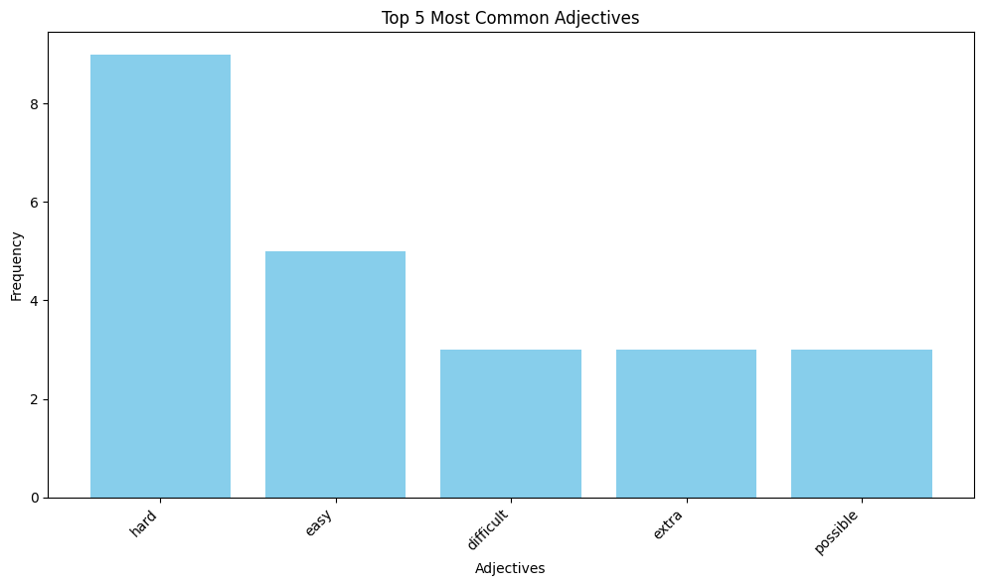
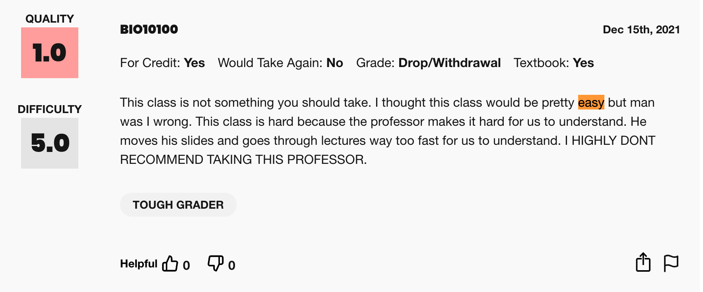
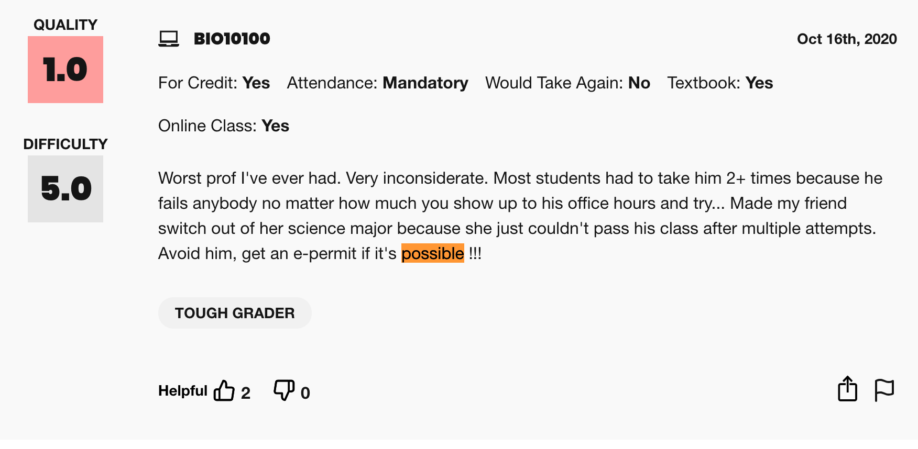

Slide 13
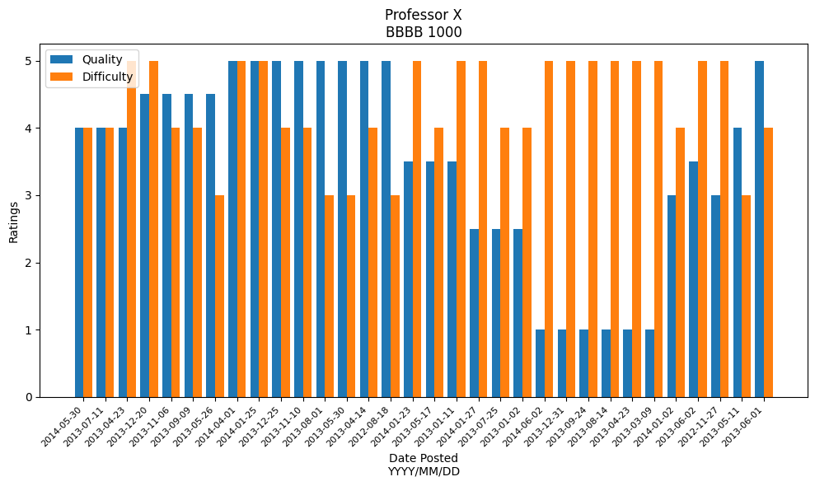
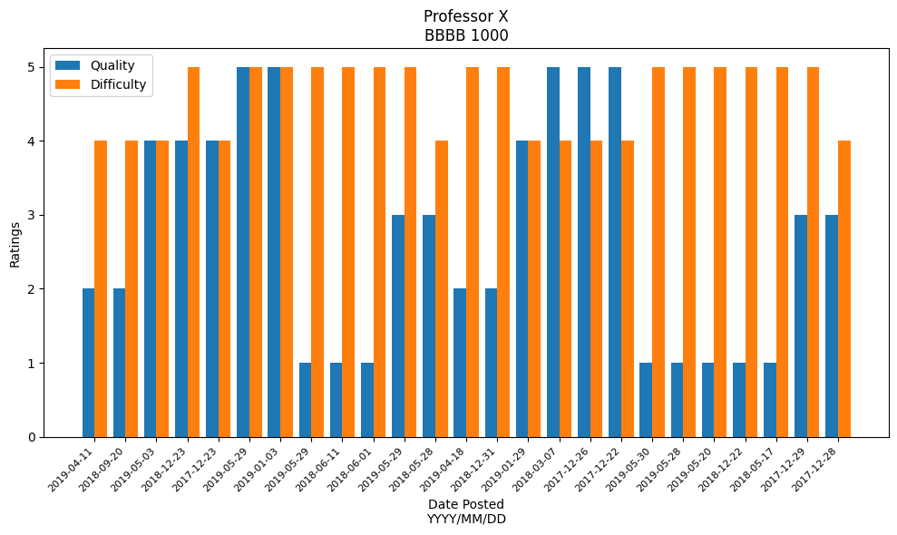
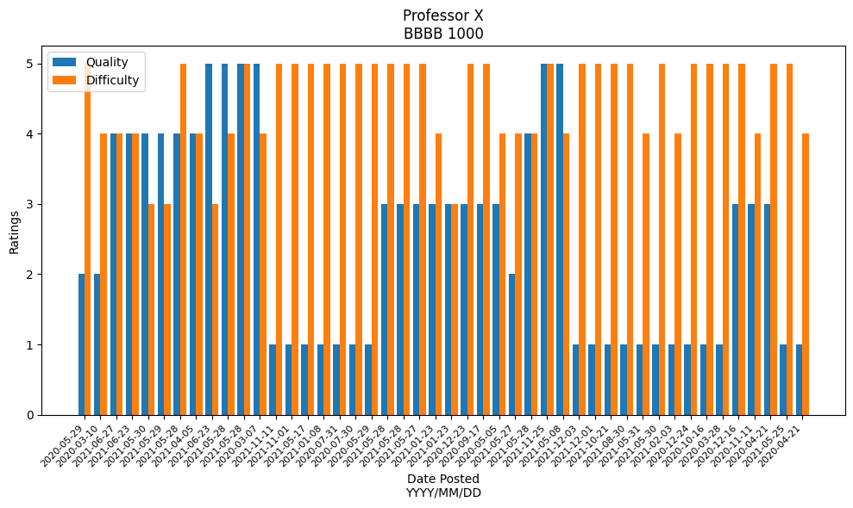
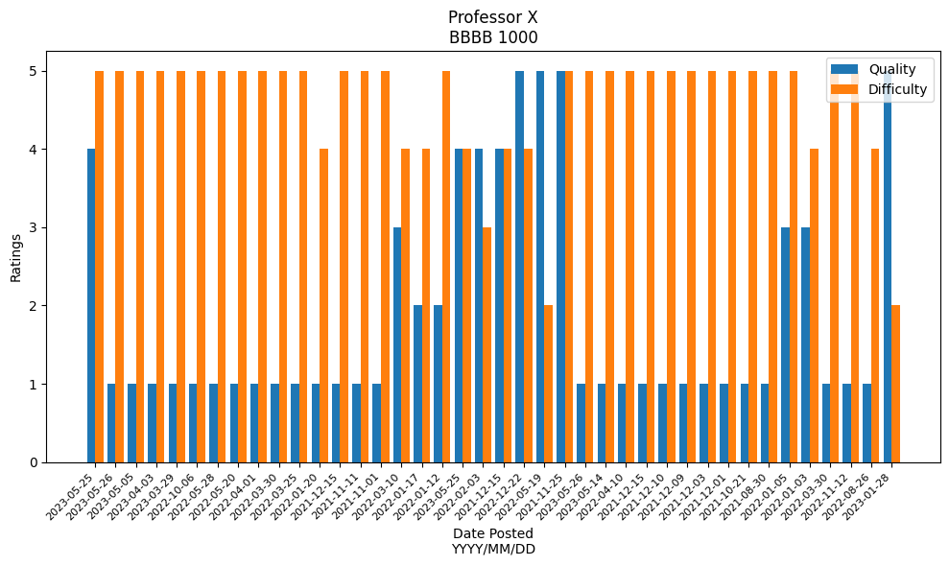
Professor X (2012-2014)
Professor X (Pre COVID)
Professor X (During COVID)
Professor X (Post COVID)

Slide 14
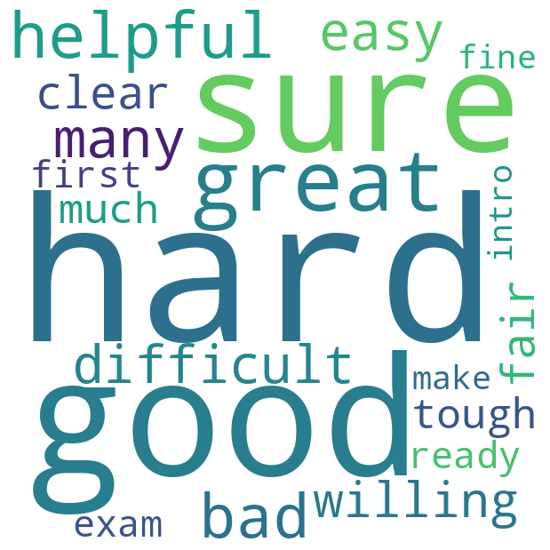
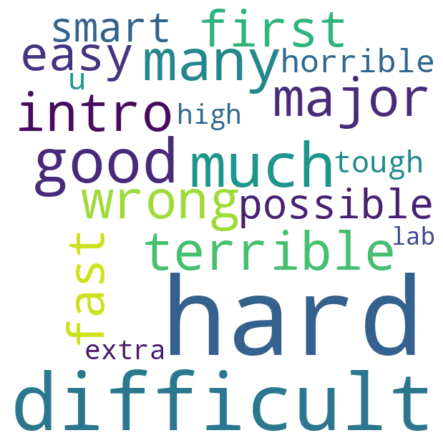
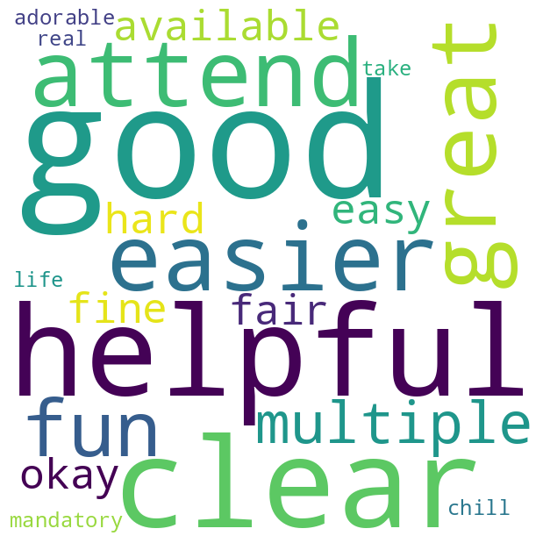
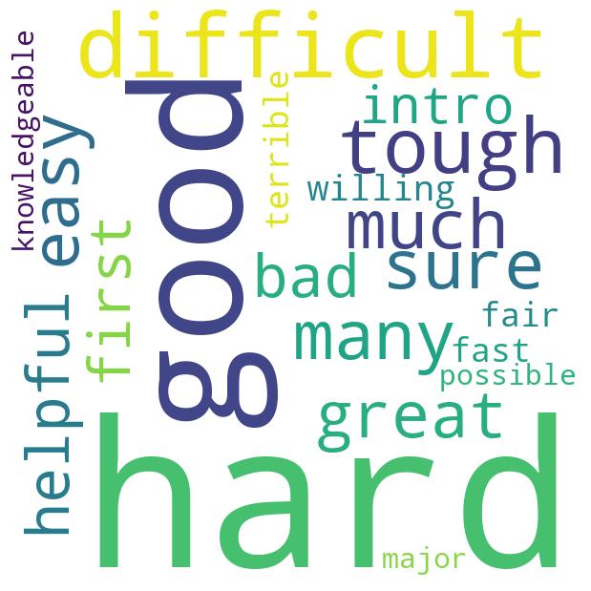
Quality [4.0, 5.0]
Quality [1.0, 2.0]
Difficulty [1.0, 2.0]
Difficulty [4.0, 5.0]

Slide 15
Result
Out of a total of 2,004 reviews, 869 were given by students taking courses at the 1000 level.
The student population include freshmen, transfer students, Psychology and non Biology major.
Suggestions for E-Permit / E-credit
Materials and syllabus component
Exam format

Slide 16
Psychology at The City College of New York
Total reviews collected: 2,850
Reviews came from courses such as PSY101, PSY102, PSY215, PSY321

Slide 17
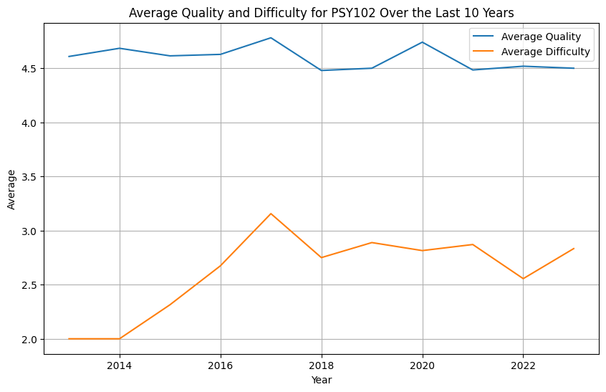
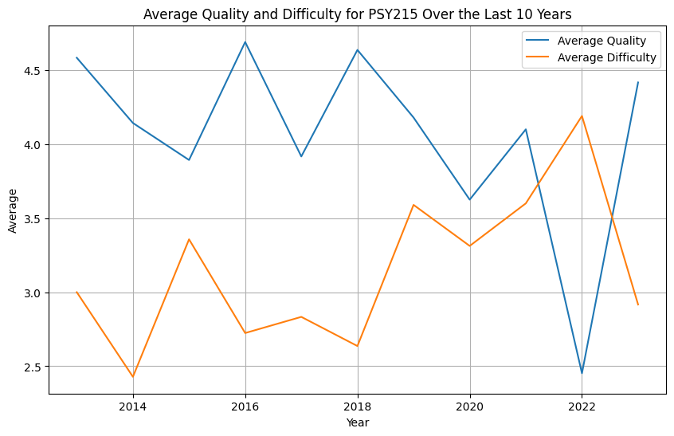
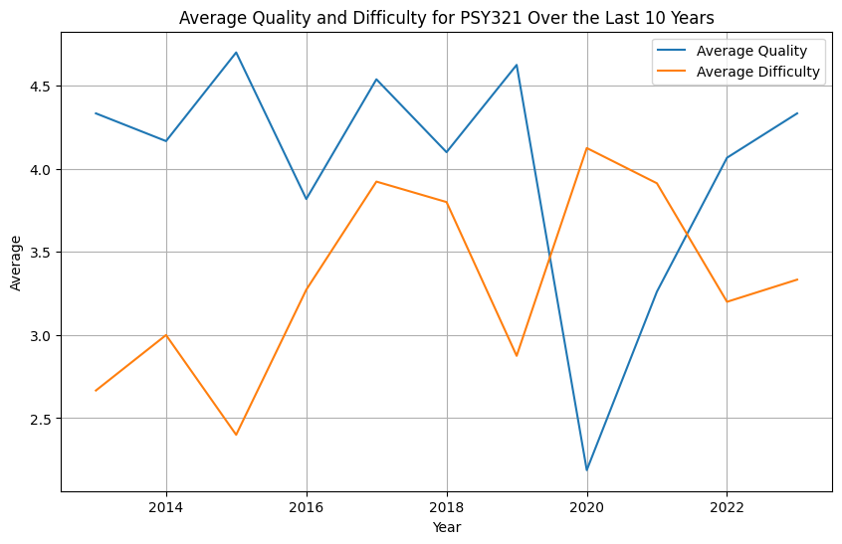
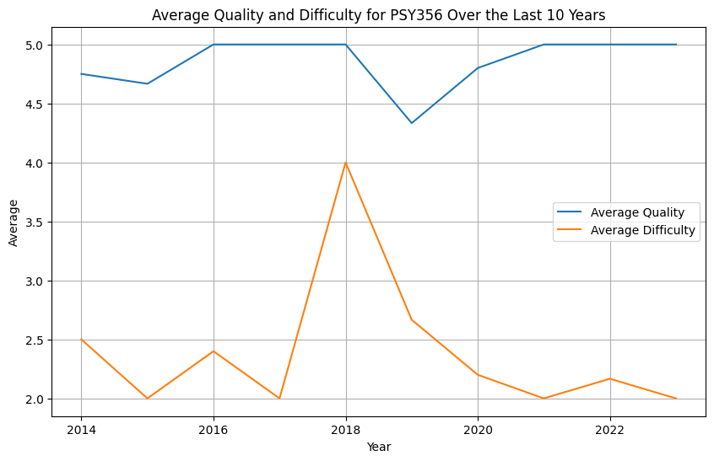

Slide 18
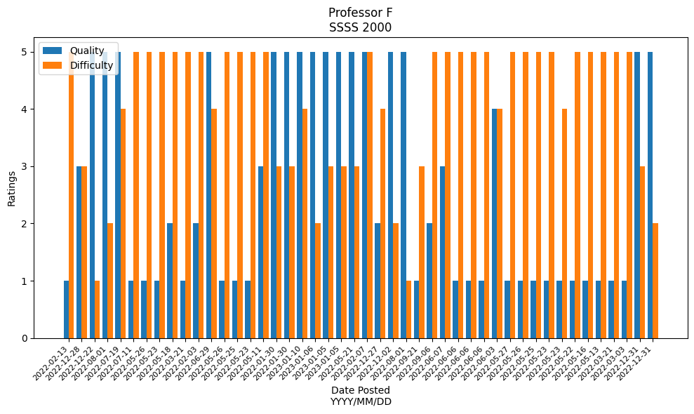
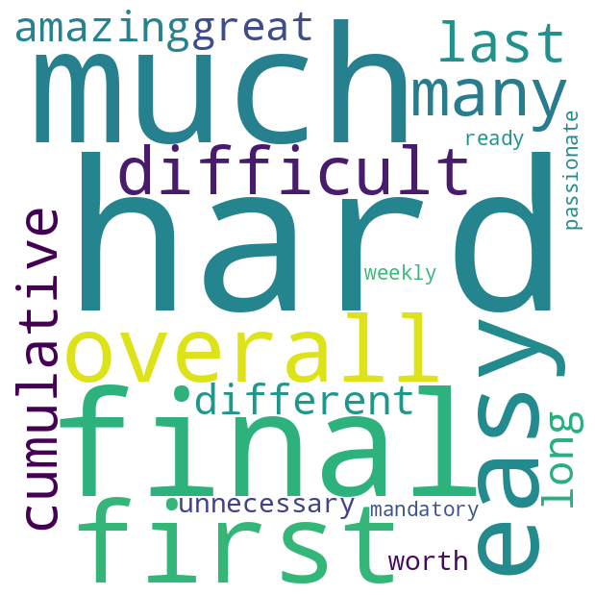
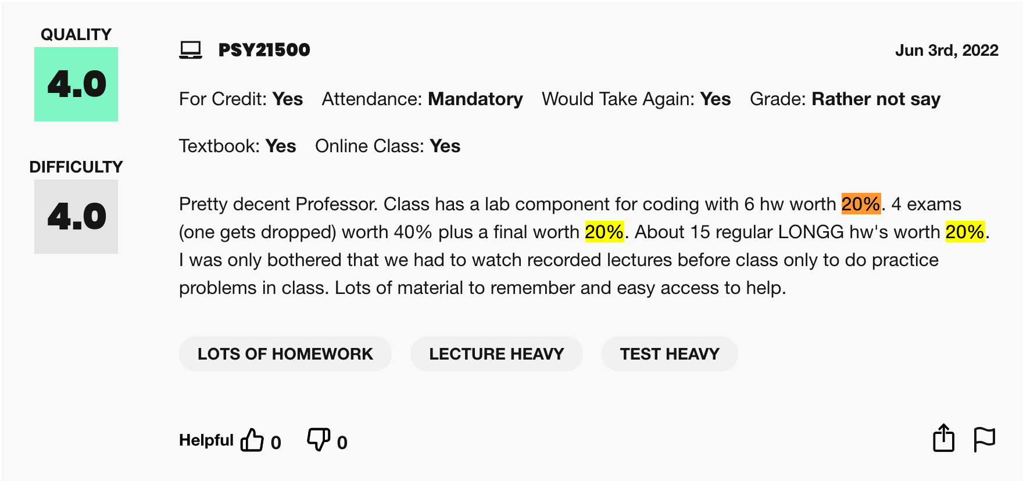
Required statistics course
Mandatory attendance
Pre Recorded lectures
Difficulties in homeworks and exams
Review sessions before the final exam

Slide 19
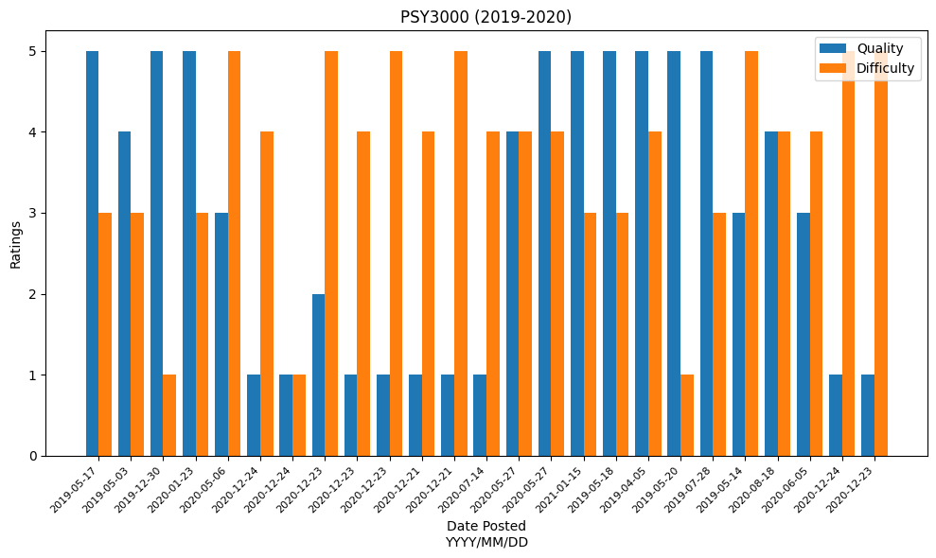
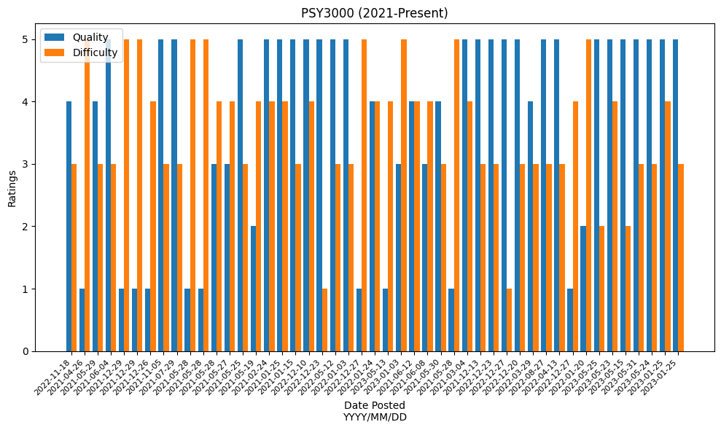
4 credit class
4 exams, 10 quizzes, 2 papers and a jury study. Difficult grading policy
Online learning during the pandemic
Fair grading policy
Grades consisting of research proposal, jury study, pop quizzes and a final
Recitation and its benefits
Workshops being helpful for quizzes

Slide 20
Future Goals
Collect reviews from New York City College of Technology
Analyze data from pre COVID, post COVID and during COVID to see how reviews have changed and impacted student body
Compare courses curriculum and reviews to find similarities and differences in two different schools
Investigate differences in teaching methods, exam formats and grading policy

Slide 21
Acknowledgement
Dr Brathwaite
For the time and guidance he has provided me with. I am incredibly grateful for the guidance and insights provided by my mentor throughout my journey in the Data Science Scholars program.
The Grove School of Engineering Data Science Scholars program
By participating in the Data Science Scholars program, I was able to explore a field that is completely new to me and acquire skills that I can benefit from in the future. The experience has sparked my interest in continuing the research, and I look forward to contributing to meaningful projects that will help me explore other components in the world of data science.

Slide 22
Thank you!

